Slide 1
Auto Sweep Tool
Speaker Name Title Goes Here

Slide 2
Background
Sapphire Rapids introduces an Active Idle Efficiency Mode, a feature that targets CPU energy efficiency by lowering uncore frequency under low activity scenarios.
The Active Idle feature provides the capability to program the desired utilization threshold points as well as the uncore frequency to achieve desired power versus utilization graph for different SKUs.
The purpose of this tool is to make it easy for users to quickly select the best config that meets their requirements from many Active Idle configurations : the power consumption is saved while the impact on performance is limited as much as possible.

Slide 3
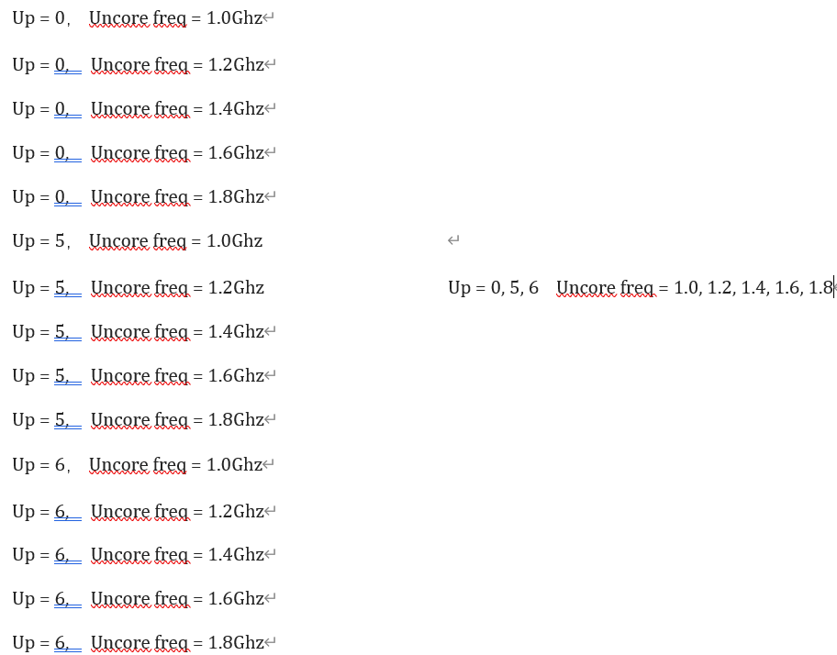
Advantages
Easy way to do the configuration to cover all the combinations
One-click tool to run all tests automatically
Parse all the results automatically and generate a report

Slide 4
Scope
We currently use SPECCPU and SPECJBB as tools for evaluating performance impact and SPECPower as a tool for evaluating power savings.
In order to adapt to more scenarios, the configurations we now support are:
active idle
uncore_ceiling
utilization_point
uncore_freq
FC1E

Slide 5
Prerequisites
Need to prepare in advance：
SPECJBB2015 1.03
SPECCPU2017 1.0.2
SPECPower2008 1.12
PTU
Python3
Third party library：lxml , xlwt

Slide 6
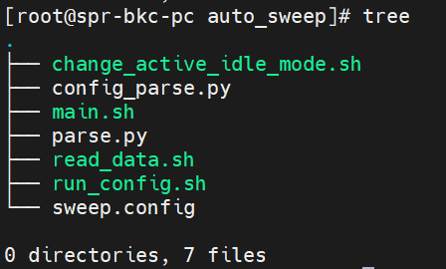
Composition
sweep.config -- Configuration information
main.sh -- Scripts directly called by users, parse the configuration file and generate all the configuration previews to be run
config_parse.py -- Parse the configuration file and generate all the configuration previews to be run. Excel file of preview configuration will be generated in the result path
read_data.sh -- Read the preview configuration file and pass it to run_config.sh
run_config.sh -- Execution script of benchmark
change_active_idle_mode.sh-- Scripts for changing active idle status
parse.py -- Parse the result and generate result.xls
Note: What users directly use and operate are sweep.config and main.sh

Slide 7
Sweep.config
active_idle : If it is turned off, both utilization_point and uncore_freq parameters will be invalid
uncore_ceiling : Set max uncore frequency
utilization_point : Utilizations below this point will engage the feature and set the desired uncore frequency.
uncore_freq : Desired Uncore frequency during Active Idle condition
FC1E : A new feature that debuts in SPR
workload_list : Include the name and iteration number of workload
output_path : Path of output
In sweep.config, there are twelve settings that can be filled in

Slide 8
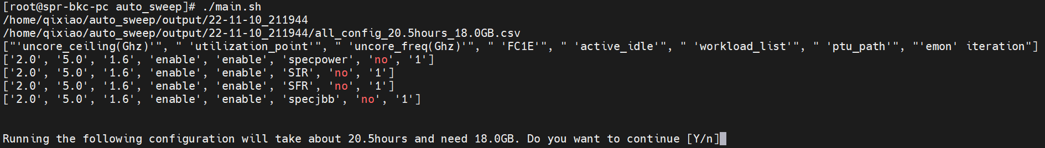
Quick start
$ ./main.sh –h
The function of -c is to add the path of sweep.config. This parameter will work when you use the tool several times
After running main.sh, all configuration information(including running time and required space) and will be printed on the screen and stored in a configuration summary file for confirmation before using the tool for a long time. If you are already familiar with using this tool, you can skip this step by using the parameter - y to achieve automatic deployment of multiple machines

Slide 9
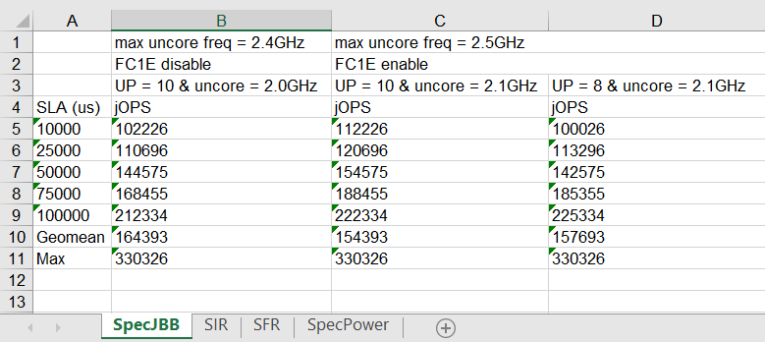
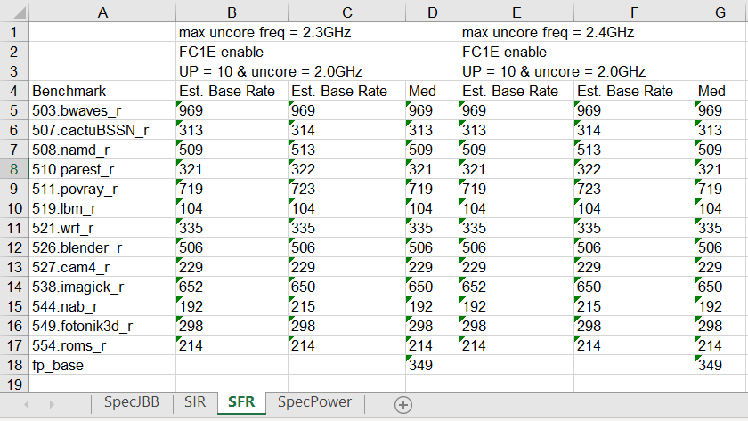
Result Summary
The benchmark results will be extracted from the logs in the output path of sweep.config and then exported to an XLS in the same path.
The generated XLS includes 4 sheets named SpecJBB, SIR, SFR and SpecPower respectively, each of which is a table holding the data of the corresponding workload.
Two rounds of test results and their mean

Slide 10
Future work
Select the configuration required by users more intelligently
Add more workloads
Add CPU utilization as an adjustable parameter
Add emon support

Slide 12
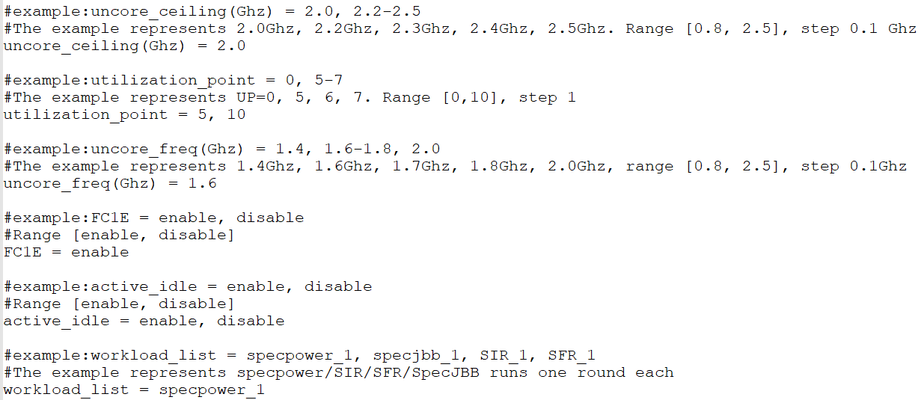
Sweep.config
Notes:
format

Slide 13
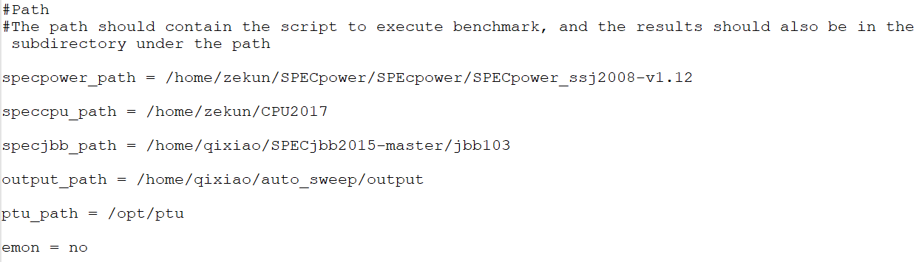
Sweep.config
Notes:
format

